Slide 1
God Rules In The Kingdoms Of Men
Habakkuk chapter 1

Slide 2
God Rules The Universe From Beginning To End
He Is Lord Of Heaven And Earth. Acts 17:22-31
— "Righteousness exalteth a nation: but sin is a reproach to any people" (Proverbs 14:34).
— "It is an abomination to kings to commit wickedness: for the throne is established by righteousness" (Proverbs 16:12).

Slide 3
Reminder
Ecclesiastes 9:1“For all this I laid to my heart, even to explore all this: that the righteous, and the wise, and their works, are in the hand of God.”
Ecclesiastes 3:11“Man cannot find out the work that God hath done from the beginning even to the end.”

Slide 4
Reminder
Deuteronomy 29:29 “The secret things belong unto Jehovah our God; but the things that are revealed belong unto us and to our children for ever, that we may do all the words of this law.”
Therefore we “walk by faith, not by sight (2 Corinthians 5:7), we “Trust in Jehovah with all thy heart, And lean not upon thine own understanding: In all thy ways acknowledge him, And he will direct thy paths.” (Proverbs 3:5-6)

Slide 5
God’s Rule Includes Chastening And Judgment Of Nations
God judged the world- Flood. Genesis 6-9
Babel…God chastened those who tried to build “a city and a tower, whose top may reach unto heaven.” scattering them “upon the face of all the earth.” Genesis 11:1-9

Slide 6
God’s Rule Includes Chastening And Judgment Of Nations
NOTE: God's chastening and judgments reflect His patience and love as He seeks to save men.
Cf. Ezekiel 33:11 “I have no pleasure in the death of the wicked; but that the wicked turn from his way and live..”
Amorites. When God promised the land of Canaan to Abram, He delayed the fulfillment of the promise for four generations because "the iniquity of the Amorites is not yet full" (Genesis 15:16).

Slide 7
God’s Rule Includes Chastening And Judgment Of Nations
Sodom and Gomorrah were utterly destroyed for their homosexual sins by fire and brimstone which God rained down upon them. Genesis 18-19
Note: 19:23-25
Spared if God could have found only ten righteous people (Genesis 18:23-33).

Slide 8
God’s Rule Includes Chastening And Judgment Of Nations
Israel warned: Deuteronomy 4, 8, 30; Joshua 23:16ff
God sent chastisements and judgments upon Israel, the Northern kingdom, which were not taken to heart (Isaiah 9:8ff)
  “Prepare to meet thy God.” Cf. Amos 4:6-13
Assyria to be the instrument of God’s wrath.
(Isaiah 10:5ff)

Slide 9
God’s Rule Includes Chastening And Judgment Of Nations
Israel taken captive by Assyria. 722 B.C. 2 Kings 17:1-18
Stubborn:
“Hardened their neck” (vs. 14)
“Rejected statutes…” (vs. 15)
Idolatry. (vs. 17)
Judah spared.
Hezekiah’s prayer. (2 Kings 19:19)
Judah without weapons. (2 Kings 18-19; Hosea 1:7)

Slide 10
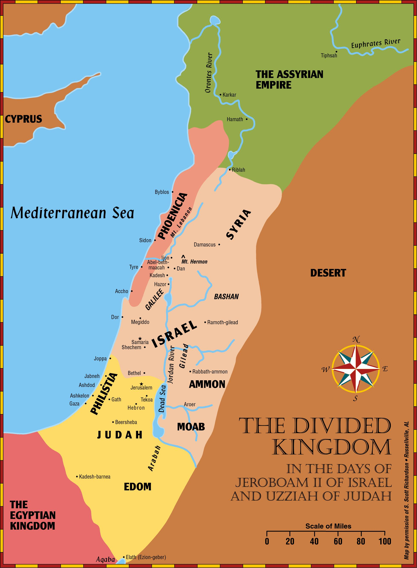

Slide 11
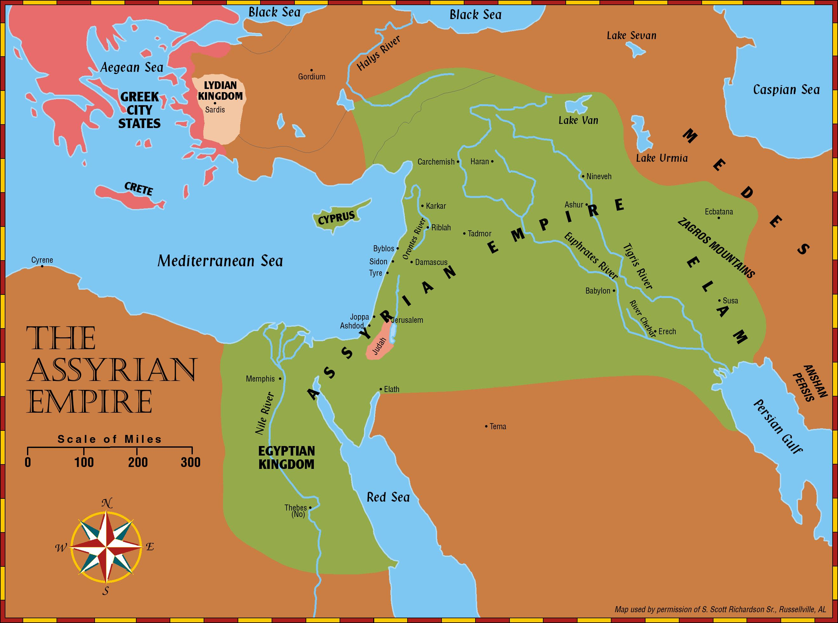

Slide 13
God’s Rule Includes Chastening And Judgment Of Nations
Assyria to be destroyed.
The fall of Assyria, long previously prophesied by Isaiah.
(Isaiah 10:12-19)
In 612 B.C. Nabopolassar united the Babylonian army with an army of Medes and Scythians…. Prophecies of Zephaniah (Zephaniah 2:13-15) and Nahum, fulfilled.
Complete destruction of Assyria warning to the Egyptians. Ezekiel 31:1ff

Slide 15
God’s Rule Includes Chastening And Judgment Of Nations
Judah to be destroyed by Babylon. Jeremiah 25:8-11, 31
In 605 B.C. in the fourth year of Jehoiakim’s reign, Nebuchadnezzar, King of Babylon invaded Judah (Jer. 36-39), besieging Jerusalem and carried away captives to Babylon.
Jehoiakim destroyed the scroll. Jeremiah wrote again. (Jeremiah 36:28-31)
Zedekiah appointed King of Judah. Jerusalem falls (586 B.C.)
  Judah falls! (Jeremiah 39:6-8)

Slide 16
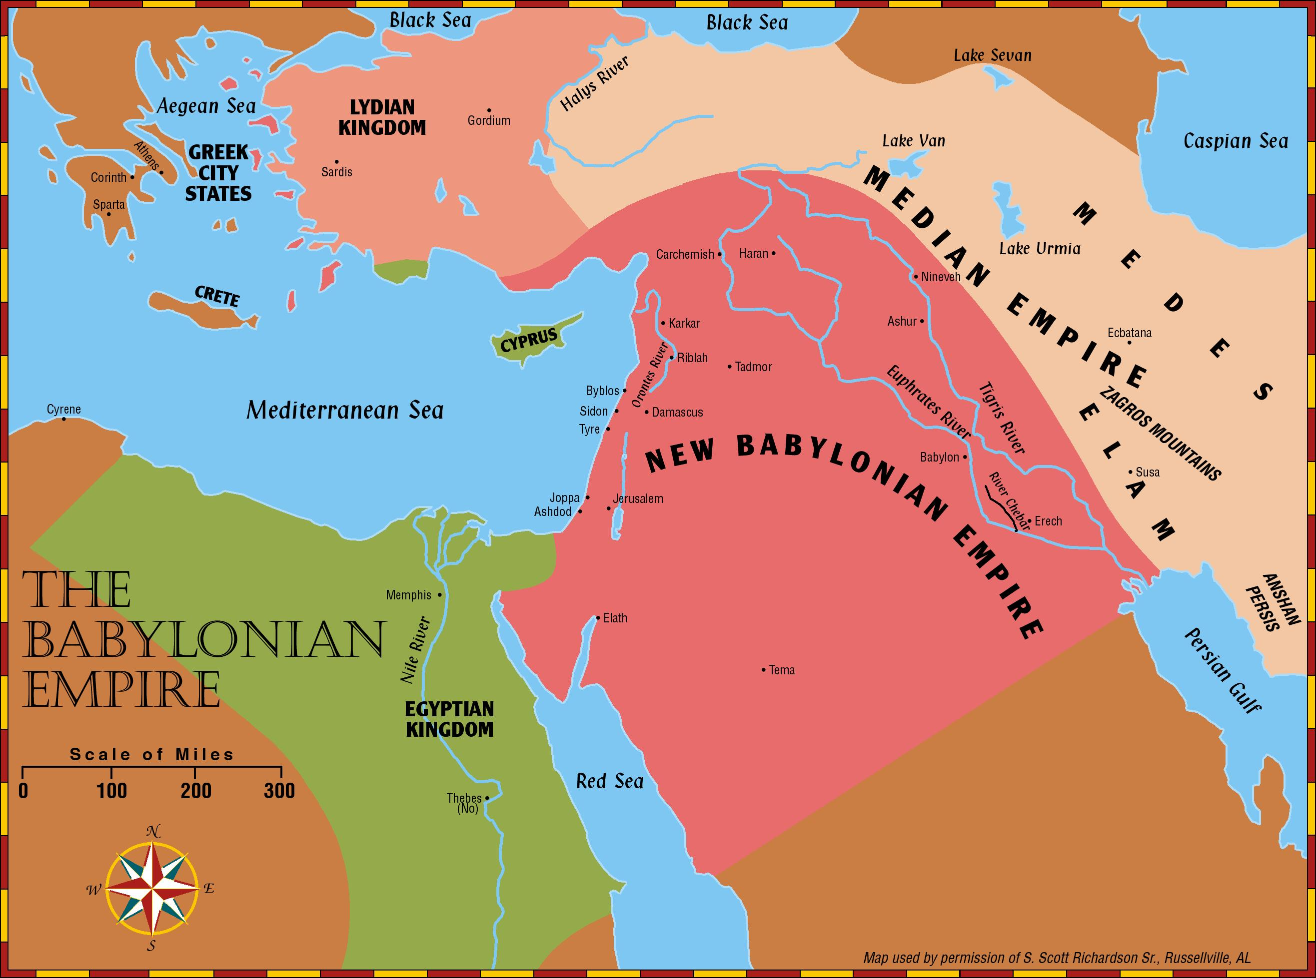

Slide 18
God’s Rule Includes Chastening And Judgment Of Nations
Babylon to be destroyed and the city would not be inhabited. Isaiah 13:1, 17-22;
Jeremiah 50-51
Grandeur of Babylon, the capital of Chaldea, "the glory of kingdoms" and "the beauty of the Chaldeans' pride." (Isaiah 13:19)
cf. Daniel 4:30 “I have built…”
Note: Daniel 4:17

Slide 19
God’s Rule Includes Chastening And Judgment Of Nations
Babylon to be destroyed
Grandeur of Babylon according to the Greek historian Herodotus (5th century B.C.)
Walls 60 miles. 300 feet tall. 87 feet wide
Archaeological excavations (1899-1917, 1958)
Two walls about eleven miles long. Outer wall was 25-feet thick and the inner one was 23-feet thick. Population 500,000.

Slide 20
God’s Rule Includes Chastening And Judgment Of Nations
Babylon to be destroyed and the city would not be inhabited. Isaiah 13:1, 17-22; Jeremiah 50-51
In 539 B.C., Babylon was conquered by Cyrus (Cf. Isaiah 44:27ff), leader of the Medo-Persian alliance. Herodotus says that the army of Cyrus diverted the Euphrates River and then marched up the dry riverbed under the city walls. Babylon fell without a fight. (Cf. Jeremiah 50:38; 51:36-37)
Babylon, the “great city” has “become heaps, a dwelling place for jackals” Jeremiah 51:37.

Slide 21
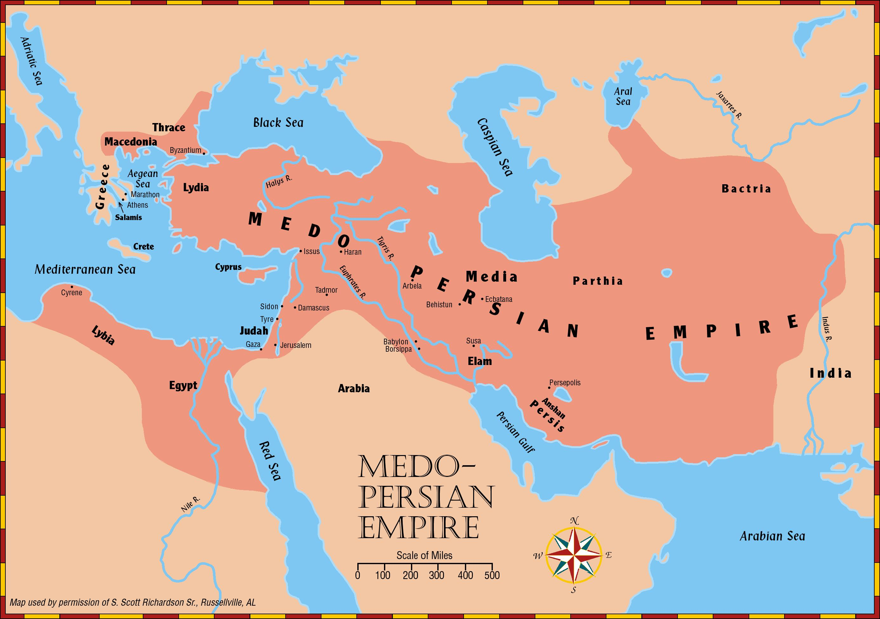

Slide 23
God’s Rule Includes Chastening And Judgment Of Nations
All the world should see, "the most High ruleth in the kingdom of men, and giveth it to whomsoever he will, and setteth up over it the basest of men" (Daniel 4:17;
Cf. Daniel 2).
All the world should see, "The Lord is in his holy temple: let all the earth keep silence before him" (Habakkuk 2:20).

Slide 24
God Overrules The Wicked To Accomplish His Purposes
1. The King of Assyria was in the hand of God,
“…the rod of mine anger" against sinful nations, "howbeit he meaneth not so, neither doth his heart think so; but it is in his heart to destroy and cut off nations not a few"
(Isaiah 10:5-7).
2. The King of Babylon was in the hand of God, God said that after using Assyria to chastise and destroy sinful nations, "I will punish the fruit of the stout heart of the king of Assyria, and the glory of his high looks" (vs. 12).

Slide 25
God Overrules The Wicked To Accomplish His Purposes
3. Medes and Persians in the hand of God… God saw the sins of Babylon and announced woes against it (Habakkuk 2:5-20). "But the Lord is in his holy temple: let all the earth keep silence before him" (vs.20).
The prophet learned that we must "wait" for God to fulfill His purposes in His own time and way, for "the just shall live by his faith" (2:1-4).
NOTE: ROMANS 1:16-17

Slide 26
God Overrules The Wicked To Accomplish His Purposes
In Habakkuk 3, Habakkuk praised the majesty of God and affirmed his trust in Him in the face of every tragedy and dilemma of life.

Slide 27
Human Power Cannot Overrule or Defeat God
Stubbornness and arrogance caused Pharaoh to ask, “Who is Jehovah that I should obey his voice?” (Exodus 5:2)
Material prosperity cannot deliver a nation from the hand of God.
When God announced he would "stir up the Medes" to destroy Babylon, God said they could not be bribed or bought off.
(Isaiah 13:17)

Slide 28
Human Power Cannot Overrule or Defeat God
Military might cannot deliver a nation from God's hand.
"He delighteth not in the strength of the horse: he taketh not pleasure in the legs of a man. The Lord taketh pleasure in them that fear him, in those that hope in his mercy"
(Psalms 147:10-11).

Slide 29
What Can We Do?
"In the day of adversity consider"
(Ecclesiastes 7:14)
  Pray! (1 Timothy 2:1-6)
  Examine ourselves! (2 Corinthians 13:5)
  Help others to seek God! (Acts 17:26-27; 8:4)

Slide 30
Conclusion: God Rules
We do not know WHAT the future holds, but we know WHO holds the future.
In uncertain times, people should see our unshakeable faith in God!
  Cf. Hebrew 12:28 “Wherefore, receiving a kingdom that cannot be shaken, let us have grace, whereby we may offer service well-pleasing to God with reverence and awe: for our God is a consuming fire.”
All the world should see in us the reverence expressed by Habakkuk,
"The Lord is in his holy temple: let all the earth keep silence before him" (2:20).

Slide 31
Conclusion: God Rules
God still rules in the kingdoms of men.
Jeremiah 27:5
Sin is still a disgrace to any people. Proverbs 14:34
Apart from God, all our efforts are vanity. Ecclesiastes 1:2
Satan still tempts us. 1 John 2:15-17
Let us “fear God and keep his commandments.”
Ecclesiastes 12:13-14

Slide 32
People who are not serving God must be told that the future holds a final judgment, when we all will stand in His presence, followed by eternity in heaven or hell.
1. He has appointed a day. Acts 17:30-31
2. Let the erring Christian confess his sins, repent, and pray God's forgiveness. Acts 8:22-24.
3. Let those who have never obeyed the gospel put their faith in Christ, repent, confess his name, and be immersed in water for the remission of sins. Mark 16:15-16; Acts 2:38; Romans 10:10

