Slide 1
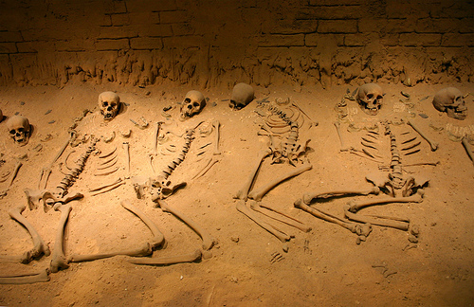
Archeology of the Bible in an Enlightened Age Part 1
(New Testament)
Jonathan Moore DPM, MS, MA

Slide 2

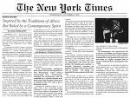

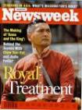


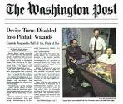



The Battle for Truth in a Postmodern World

Slide 3
New Definitions in an Enlightened Age
Truth means whatever is right for you.
Tolerance means accepting that each individual’s values and lifestyles are equally valid.
Moral judgments mean bigoted attitudes we have no right to hold.

Slide 4
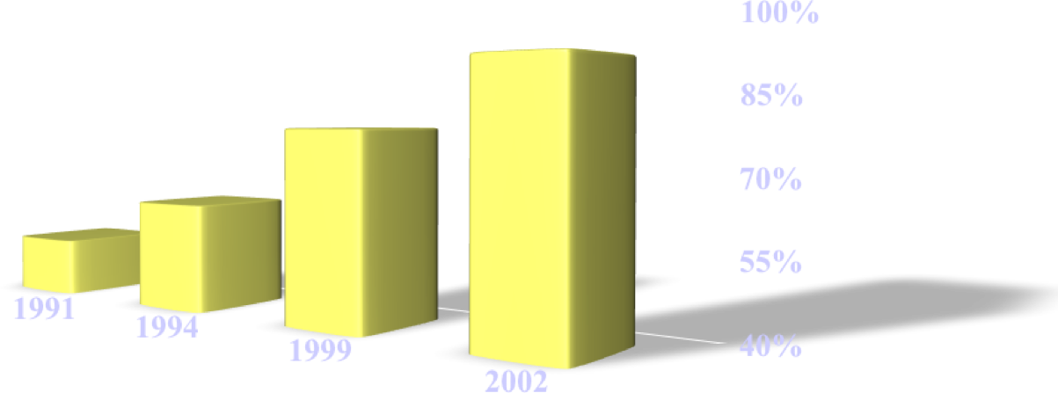
“There is no absolute truth”

Slide 5
Biblical Interpretation
People are reading literature (including the Bible) differently than before.
Literary interpretation uses what is called“postmodern deconstruction.”
In other words…
the Bible isn’t viewed as Reliable, Authentic nor Relevant…

Slide 6
John 18:38
Pilate said to him, “What is truth?” After he had said this, he went back outside to the Jews and told them, “I find no guilt in him.

Slide 7

What is our Philosophy?
In the scriptures the philosophy of life is sometimes represented by the word “mind”
Phil. 2:5
[5] Let this mind be in you, which was also in Christ Jesus:
Are we “ taking every thought captive to the obedience of Christ” (2 Corinthians 10:5).

Slide 8
The way a person thinks influences his behavior – Proverbs 4:23
[23] Keep thy heart with all diligence; for out of it are the issues of life. (KJV)
Keep your heart with all diligence, For out of it spring the issues of life. (NKJV)
The thinking of a society – of a people – can be changed over time. Either by force or by subtle means

Slide 9

What is Postmodernism?

Slide 10
Postmodernism defined/described
Postmodernism denies ABSOLUTE TRUTH and ABSOLUTE MORALS
It works to destroy the FOUNDATIONAL BELIEFS and MORAL VALUES of prominent structures in our society – especially CHRISTIANITY
Postmodernism wants to banish Christianity (undermine it) because of its claims of exclusivity

Slide 11
Is Truth Exclusive?
Law of Non-contradiction – A and the opposite of A cannot both be true.
Many believe that truth claims are “both/and” rather than “either/or.”
Mutually exclusive propositions cannot both be true (square circles).

Slide 12
An Exclusive Claim
John 14:6 – Jesus said to him, “I am the way, and the truth, and the life; no one comes to the Father but through Me.”
Jesus taught that salvation was through Him and no one else.
This contradicts other religions.

Slide 13
There is absolute truth
Jn. 17:17; 8:32
[17] Sanctify them through thy truth
[32] And ye shall know the truth, and the truth shall make you free: thy word is truth.
There is an absolute moral standard – 1 Th. 5:22
{22} Abstain from every form of evil.

Slide 14
Postmodernism
“The point of postmodernism is not ‘truth’ but power. Unable to defeat the power of the word of God through argument, postmodernists seek to dismiss God, to gag him by making him irrelevant.” (Sanders, 26)
Postmodernism refuses to permit any group’s belief to dominate any other group

Slide 15
Postmodernist
They say Christians can believe in the Deity of Christ, miracles and the inspiration of the Bible – BUT, they want Christians to be TOLERANT of all views
Most all DENY the Deity of Christ, miracles, the inspiration of the Bible

Slide 16
Postmodernism
As New Testament Christians we are disgusting to the postmodern thinker since we believe there is only one God, one faith, one church, one baptism, and one gospel
“They are vocally intolerant of any view that describes itself as ‘the truth’, especially Christianity.” (Sanders, 26)

Slide 17
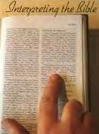
Biblical Interpretation
Many Christians no longer interpret the Bible by what it says.
Instead, they interpret the Bible by either asking what the passage means to them.
Furthermore, some dismiss the Bible all together finding peace in the fact that they are a “good person”
Does it make sense that God would give us His word containing messages that have 2, 3, 50 or 100 different interpretations that conflict each other?

Slide 18
There is a standard that exists – the Word of God – Jn. 17:17
[17] Sanctify them through thy truth, they Word is truth
Acts 26:25
[25] But he said, I am not mad, most noble Festus; but speak forth the words of truth and soberness.

Slide 19
Col. 2:20-23
20 Therefore, if you died with Christ from the basic principles of the world, why, as though living in the world, do you subject yourselves to regulations—
21 “Do not touch, do not taste, do not handle,”
22 which all concern things which perish with the using—according to the commandments and doctrines of men?
23 These things indeed have an appearance of wisdom in self-imposed religion, false humility, and neglect of the body, but are of no value against the indulgence of the flesh.

Slide 20
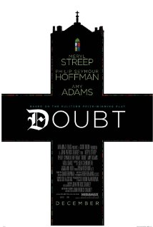
Has our Postmodern, Science Worshiping World Seeded doubt in your mind about the Reliability of the Bile?

Slide 21
Reason and Logic
Can you know if Bible we have today is the same as the original? (Issue of accuracy of translation and copying)
Assuming that the translation/copying is accurate, can we know if the writers did not make up the stories?
Can we know that the Bible is not just a myth that was embellished over time?

Slide 22
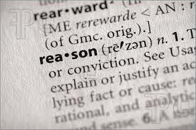
Only if you use logic and reasoning

Slide 23
What does the Bible Claim?
Paul stated: “All scripture is given by inspiration of God, and is profitable for doctrine, for reproof, for correction, for instruction in righteousness: that the man of God may be perfect, throughly furnished unto all good works” (2 Timothy 3:16-17).
Peter wrote: “Knowing this first, that no prophecy of scripture is of private interpretation. For no prophecy ever came by the will of man: but men spake from God, being moved by the Holy Spirit” (2 Peter 1:20-21).

Slide 24
Bible Claims
“God said…” or “these are the words of the Lord…” appear thousands of times in both the Old and New Testaments.
Moses wrote in Exodus 20:1:“And God spake all these words....”
The psalmist wrote in 119:89: “For ever, O Jehovah, Thy word is settled in heaven.”
In Matthew 22:31, the Lord asked: “Have ye not read that which was spoken unto you by God?”
There are 2,700 such statements in the Old Testament alone, all of which make direct claim that the Bible is the Word of God

Slide 25
Bible Claims
More than 3,800 times in the Old Testament, the claim is made that the Scriptures are the word [or words] of God.
For instance, And Jehovah said unto Moses, Write this for a memorial in a book.... (Exodus 17:14).
David declared: .The Spirit of Jehovah spake by me, and his word was upon my tongue. (2 Samuel 23:2).
God instructed the prophet Jeremiah; Behold, I have put my words in your mouth. (Jeremiah 1:9).
The Scriptures are exalted as the Word of God some 175 times in Psalm 119 alone!

Slide 26
What is Inspired…?
What is inspired—the autographs or the copies? Inspiration applies specifically to the original autographs of the Bible not to copies and translations.
This should not cause concern about whether your Bible is truly the Word of God. As Geisler says,
  “Even when the accuracy of a reading in the original text cannot be known with 100 percent accuracy, it is possible to be 100 percent certain of the truth preserved in the texts that survive. It is only in minor details that any uncertainty abut the textual rendering exists, and no major doctrine rests on any one minor detail. A good translation will not fail to capture the overall teaching of the original. In this sense, then, a good translation will have doctrinal authority, although actual inspiration is reserved for the autographs” (Geisler and Nix, p. 44).

Slide 27
Definition of Inerrancy
“…holds that men wrote exactly what God wanted them to write, without errors or mistakes, yet with their own personalities in evidence in their writings. By “verbal,” we mean that every word in the Bible is there because God permitted it by the direction of the Holy Spirit. By “plenary” (from the Latin, plenus—full), we mean that every part of the Bible is inspired, with nothing having been omitted”

Slide 28
Inerrancy
An Inerrant Bible The result of the divine-human authorship is a message without error.
If God is true (Rom. 3:4) and the Bible comes from God (2 Tim. 3:16), then the Bible must be true in all its parts.
“Inerrancy is the view that when all the facts become known, they will demonstrate that the Bible in its original autographs and correctly interpreted is entirely true and never false in all it affirms, whether that relates to doctrine or ethics or to the social, physical, or life sciences” (Paul D. Feinberg in Evangelical Dictionary of Theology, ed. Walter A. Elwell. Grand Rapids: Baker. p. 142).

Slide 29
Definitions: Inspiration
The English term “inspiration” derives from the Latin inspirare, which means “to breathe upon or into something.”
The five English words, “given by inspiration of God,” in the King James Version of 1611 actually are translated from the single Greek adjective, theopneustos, which is derived from two Greek root words (theos—God, pneo—to blow or breathe).
Pneuma, meaning “spirit,” comes from the verb pneo.
Pneustos, then, might mean “spirited,” and theopneustos would mean God-spirited, God-breathed, filled with the breath of God, the product of the divine breath (or Spirit), or given by God through the Spirit.
The word implies an influence from without, producing effects that are beyond natural powers.

Slide 30
Plenary Verbal
It holds that men wrote exactly what God wanted them to write, without errors or mistakes, yet with their own personalities in evidence in their writings.
By “verbal,” we mean that every word in the Bible is there because God permitted it by the direction of the Holy Spirit.
By “plenary” (from the Latin, plenus—full), we mean that every part of the Bible is inspired, with nothing having been omitted.

Slide 31
Inspiration
In Matthew 5:17-18, Christ exclaimed:
  Think not that I came to destroy the law and the prophets: I came not to destroy, but to fulfill. For verily I say unto you, Till heaven and earth pass away, one jot or one tittle shall in no wise pass from the law, till all things be accomplished.
  The “jot” was the smallest Hebrew letter, and the “tittle” was the tiny projection on certain Hebrew letters. When He employed these specific terms as examples, the Lord affirmed the minutest accuracy for the whole of the Old Testament.

Slide 32
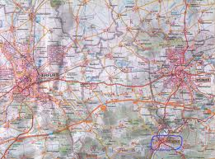
To discover whether the Bible is reliable, you need M.A.P.S.
Manuscripts
Archaeology
Prophecy
Statistics

Slide 33
The Uniqueness of the Bible
Alone among religious books in its scientific accuracy
Other ancient religious books abound in obvious scientific errors, e.g. Hindu, Greek, Muslim, Babylonian and many other “sacred” books
The Bible is in accord with modern history, geography, archaeology and science
No superstitions have corrupted the Bible, e.g.
  Astronomy -> astrology
  Chemistry -> alchemy
No other ancient book has this accuracy
No other ancient religious book could withstand this scrutiny

Slide 34
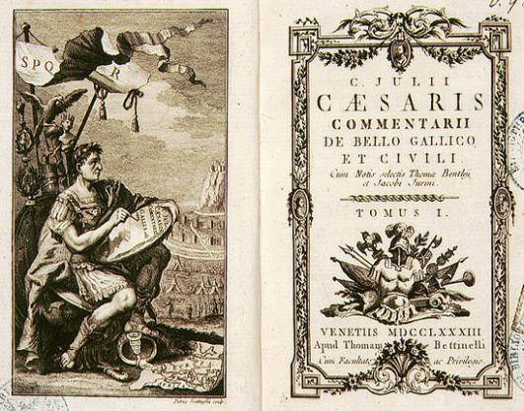
Book:
The Gallic War
Commentaries
Author:
Julius Caesar
Date of authorship: 50 BC
Notes:
We use Julius Caesar’s war commentaries as an illustration of ancient literature, written by the emperor about 50 years before the birth of Christ.

Slide 35
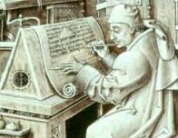
Understanding Manuscripts
Julius Caesar wrote
The Gallic War Commentaries
400 300 200 50 0 100 200 300 400 500 600
---------------------------|--------------------------------------------------
Centuries B.C. Centuries A.D.
Scribal Copying of Manuscripts
Printing Press
700 800 900 1000 1100 1200 1300 1400 1500 ---------------------------------------------------------------------- - - - -
Centuries A.D.
Notes:
This timeline has been immensely helpful to people (it is not in SBF). Caesar’s text had to be hand copied by scribes for over 1,400 years before it could be set to type after the invention of the printing press. What is put into the printing press is reconstructed from the scribal copies (remember: there is no original). How well do the copies represent the original? That is answered by the three questions we are going to consider.

Slide 36
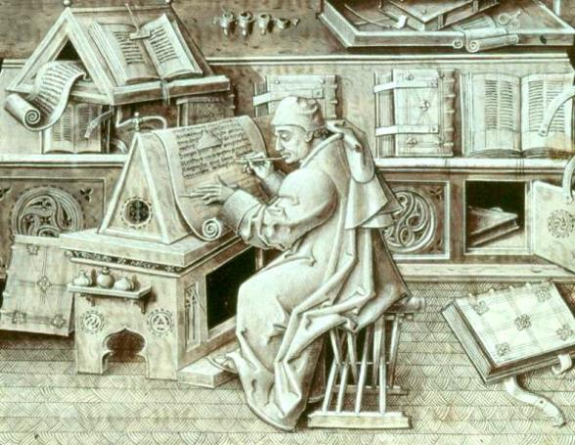
Understanding Manuscripts
Scribal copying was done by hand until invention of the printing press, c. 1439.
Notes:
This is just to reinforce that scribal copying was done for centuries before there was a printing press.

Slide 37
Ancient Manuscripts —How Many?
Notes:
Extant manuscripts of ancient writings vary in number from 1 to 643 for a given title, but there are very few which have over 100 – most have 20 or less. I always tell my groups that if all ancient writings were put on this chart, it would only extend the tail a long ways to the left because nearly all are on the low end. Make clear to your participants that there really are only 10 manuscripts ever found of the Gallic Wars – from which our current text of that work was reconstructed. Also point out that most manuscripts are incomplete. Archaeologists count every find the same, regardless whether it is whole or even a fragment. The New Testament is purposely absent in this slide so people can be made aware of other literature for comparison.

Slide 38
Ancient Manuscripts - How Many?
24,633
The BEST!
Notes:
Now we introduce the New Testament to show the remarkable difference compared to all other literature. The chart on page 31 in SBF reveals that nearly 6,000 of these copies are in the original Greek language. Another nearly 10,000 are in Latin, etc. Again, point out that all these manuscripts are prior to the printing press. If anything from ancient times can be reconstructed with accuracy, surely the New Testament can! This chart may actually mislead. The New Testament bar looks only slightly higher than the Iliad of Homer, but in actuality on the left scale it continues for another 24,000 units higher(35 times higher than is shown). Point this out.

Slide 39
Ancient Manuscripts – How accurate?
The BEST!
Notes:
“Distortion rate” includes only those variations between copies (manuscripts) which change, or potentially change, the meaning of the text. Spelling differences, word order, and other small variations generally are not included in this measurement because they do not change the meaning. Be sure to read SBF (p. 35) for additional details about these works and Dr. Metzger, the author of this study. I like to turn the percentage around – this means that 99.8% of the N.T. is not in question as a result of copying by the scribes over the centuries up to the time of the printing press. Also note the quote by F.F. Bruce on that page – an important point to include in your presentation. Not only are the N.T. manuscripts superior to any other ancient writing, the variations that do exist do not affect any doctrine or practice of the Christian faith.
Your class may want to know an example of a “distortion.” There are only two extensive ones: the ending of Mark’s Gospel (16:9-20) and the woman caught in adultery (John 7:53-8:11). These are absent from some manuscripts, often the earliest ones. If you have people look in their own Bible, they will (usually) find a footnote that says this. Most people are not aware that the footnote is there or have simply ignored it. When critics of the N.T. say there are 200,000 or more variations, more than 99% of these are insignificant (like spelling John’s name with one or two “n’s”). Again, turn this into a positive: Christianity is a historic faith and is honest and open, allowing scholarship to scrutinize its N.T. text – resulting in confidence that the integrity of the N.T. is greater than any other writing known to humanity. On the other hand, most other religions have no ancient manuscripts at all to verify the text of their sacred writings, or like the Muslims, do not allow any scrutiny of the Koran since they view that as an offense to Allah.

Slide 40
— Manuscript scholar Sir Frederic Kenyon
“Scholars are satisfied that they possess
substantially the true text of the principal
Greek and Roman writers whose works
have come down to us, of Sophocles, of
Thucydides, of Cicero, of Virgil; yet our
knowledge of their writings depends on a
mere handful of manuscripts, whereas the
manuscripts of the New Testament are
counted by hundreds, and even thousands.”
Notes:
Kenyon is a world famous scholar, though of a previous generation. Obviously, this quote is here to confirm from this renowned scholar the superiority of the New Testament manuscripts over all other ancient literature.

Slide 41
Understanding Manuscripts
Virgil wrote Aeneid
Aristotle wrote Poetics
Earliest known manuscript
400 300 200 50 0 100 200 300 400 500 600
---------------------------|--------------------------------------------------
Centuries B.C. Centuries A.D.
Julius
Caesar
Scribal Copying of Manuscripts
Earliest known manuscript
Printing Press
700 800 900 1000 1100 1200 1300 1400 1500
---------------------------------------------------------------------- - - - -
Centuries A.D.
Notes:
This slide will acquaint your group with literature other than the New Testament. Aristotle’s Poetics was written in the early 4th century B.C. but there are no known manuscripts until nearly A.D. 1100 – more than 1,400 years of scribal copying without one copy ever being preserved. The 10 manuscripts of Caesar are all from the 9th-12th centuries A.D. Virgil’s Aeneid, with about 300 years to the first manuscript, is the best of secular literature. Point out to your group that no ancient literature has manuscripts which have been found from the same century as the author (except, as we shall see later, the N.T).

Slide 42
Ancient Manuscripts - How Early?
The BEST!
Notes:
Completion of the bar graph to show the N.T. It has the shortest time between original composition and the first manuscripts. The N.T. is number one in both of the literary tests applied so far.

Slide 43
Origin of the New Testament
Early, Eyewitness Sources for the New Testament
Jesus’ Death New Testament
& Resurrection Quoted by Others
Eyewitness Time Period
30 40 50 60 70 80 90 100 110
------------------------------------------------------------------|-----------
First Century A.D.
Jesus’ Death New Testament
& Resurrection Quoted by Others
Eyewitness Time Period
30 40 50 60 70 80 90 100 110
------------------------------------------------------------------|-----------
First Century A.D.
Earliest Gospel
Manuscripts
Jesus’ Death New Testament
& Resurrection Quoted by Others
Eyewitness Time Period
30 40 50 60 70 80 90 100 110
------------------------------------------------------------------|-----------
First Century A.D.
Matthew, Mark, Luke, John
Legends of Jesus Begin
120 130 140 150 160 170 180 190 200
-----------------------------------------------------------------------------
Second Century A.D.
John Rylands Fragment
John Rylands Fragment
John Rylands Fragment
Legends of Jesus Begin
120 130 140 150 160 170 180 190 200
-----------------------------------------------------------------------------
Second Century A.D.
Legends of Jesus Begin
120 130 140 150 160 170 180 190 200
-----------------------------------------------------------------------------
Second Century A.D.
Legends of Jesus Begin
120 130 140 150 160 170 180 190 200
-----------------------------------------------------------------------------
Second Century A.D.
Legends of Jesus Begin
120 130 140 150 160 170 180 190 200
-----------------------------------------------------------------------------
Second Century A.D.
Gospels of Mary, Thomas, Phillip, Judas, etc.
Late, Legendary Sources for The Da Vinci Code
Notes:
The evidence clearly reveals that Dan Brown has his sources of authority backwards. The N.T. is based on eyewitness testimony while his sources are late and legendary. You need to point out that Mary Magdalene, Thomas, Phillip and Judas did not write these “gospels” (and other extant ones). They were dead for at least 100 years before these were written by someone else using their name to give them the appearance of being eyewitnesses (a practice called by scholars as “pseudonomous” writings). How did someone late in the second century know about the names of people who were with Jesus and select them for their writings? Undoubtedly they read about them in the earlier, genuine eyewitness four Gospels included in the New Testament.

Slide 44
“The evidence for our New Testament
writings is ever so much greater than
the evidence for many writings of
classical authors, the authenticity of
which no-one dreams of questioning.
And if the New Testament were a
collection of secular writings, their
authenticity would generally be
regarded as beyond all doubt.”
— British scholar F.F. Bruce
Notes:
A famous British scholar (died in the 1990’s) gives a good general summary of integrity and authenticity of the N.T. It also reveals the double standard of those who accept without question other literature whose integrity evidence is limited, while rejecting the N.T. with its extensive evidence. There is a bias here which is probably spiritual in nature. Frequently someone will ask me about the writings of other religions – “How do they compare with the N.T.?” I have prepared a brief answer that is on pp. 37-38 in the SDG.

Slide 45
“There is no body of ancient literature in the world which enjoys such a wealth of good textual attestation as the New Testament.” - F. F. Bruce

Slide 46
Degree of Accuracy
Even with 25 thousand NT manuscripts, they are so close that we are virtually certain of 97% - 98% of the New Testament.
For the remaining 2-3%, almost ½ are 1 and 2 word variants for spelling, adding “the”, etc. None of these affect doctrine.

Slide 47
Degree of Accuracy
“If Comparative trivialities such as changes of order, the insertion or omission of the the article with proper names, and the like are set aside, the words in our opinion still subject to doubt can hardly amount to more than a thousandth part of the New Testament.”
B.F. Westcott and F.J.A. Hort, The New Testament in the Original Greek, Vol. 1, p.2

Slide 48
Degree of Accuracy
A. T. Robertson suggests that the real concern of Textual Criticism is of a “thousandth part of the entire text.”
A. T. Robertons, An Introduction to the Textual Criticism of the New Testament, 1925, p. 22

Slide 49
Accuracy Established
“The interval then between the dates of the original composition and the earliest extant evidence becomes so small as to be in fact negligible, and the last foundation for any doubt that the Scriptures have come down to us substantially as they were written has now now been removed. Both the authenticity and the general integrity of the books of the New Testament may be regarded as finally established.”
Conclusion from bibliographical and external evidence test
Sir Frederic Kenyon, The Bible and Archaeology, p. 288

Slide 50
Conclusion:
New Testament Documents have been
Reliably translated/copied and can be regarded as Authentic

Slide 51
Archaeology and the Bible
Many Biblical figures and man-made structures have been verified by archaeology
Archaeology verifies Holy Scripture
Archaeologists now use Holy Scripture as a guide

Slide 52
Archaeology Confirms the Bible
Nothing has been found to disprove the historical accuracy of Biblical events, places, or people
Archaeology experts say:
  “It may be stated categorically that no archaeological discovery has ever controverted a biblical reference” (Glueck - Jewish archaeologist)
  “Discovery after discovery has established the accuracy of innumerable details [of the Bible]” (Albright - one of the great archaeologists)
Notes:
The science of archaeology strongly confirms the accuracy of the Bible. There are many examples of Biblical references which were said to be unlikely or wrong, only to have archaeology later prove that it was the critics who were mistaken (for example, witness the 1993 discovery of an inscription bearing the phase “House of David”, proving that King David was real). Every significant person and place mentioned in the Bible since the time of the inhabitation of the Holy Land by the Israelites (following the exodus from Egypt and the desert wandering) has now been verified.

Slide 53
Full Glueck Quote
“As a matter of fact, however, it may be clearly stated categorically that no archaeological discovery has ever controverted a single biblical reference. Scores of archaeological findings have been made which confirm in clear outline or exact detail historical statements in the Bible.”
Nelson Glueck PhD, Archeologist

Slide 54
A Skeptic’s Conclusion
Is the New Testament corroborated by archaeology?
“I began with a mind unfavorable to it (Acts), for the ingenuity and apparent completeness of the Tubingen theory had at one time quite convinced me. It did not lie then in my line of life to investigate the subject minutely; but more recently I found myself often brought in contact with the book of Acts as an authority for the topography, antiquities, and society of Asia Minor. It was gradually borne in upon me that in various details the narrative showed marvelous truth.”
Sir Wm. Ramsay, St. Paul the Traveller and the Roman Citizen, p. 8

Slide 55
A Reporter’s Conclusion
“In extraordinary ways, modern archeology has affirmed the historical core of the Old and New Testaments--corroborating key portions of the stories of Israel’s patriarchs, the Exodus, the Davidic monarchy, the life and times of Jesus.”
Jeffrey Shelter, “Is the Bible True?”, US News and World Report, Oct. 25, 1999, p. 52

Slide 56
A Scientist’s Declaration
“The grand old Book of God still stands; and this old earth, the more its leaves are turned over and pondered, the more it will sustain and illustrate the sacred Word.”
James Dana, Yale professor, President of the Geological Society of America and the American Association for the Advancement of Science” quoted in The Bible: Fact or Fiction? by Dr Robert G. Witty, p 91

Slide 57
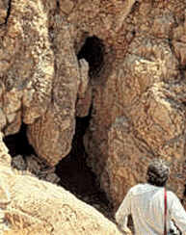
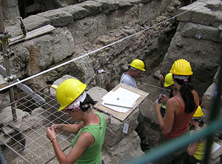
Does Archaeology Verify The Bible?

Slide 58
The Bible & Archaeology
Confirms historical accuracy of the Bible
  Ancient sites, civilizations, characters
Improves our understanding of the Bible
  Nuances and use of biblical words
Illustrates/explains Bible passages
  Events, time, culture, society, politics
1000’s of archives discovered, but
  Alexandria Library (1M+ MS) lost in 7th century fire
Many archaeological sites yet to be excavated
  Our knowledge is still limited

Slide 59
Accuracy of Acts
WHOEVER HEARD OF "POLITARCHS"?
Ac 17:6 - CONCERNING THE TERM "RULERS OF THE CITY" (GREEK "POLITARCHS")...
Since the term is not found in the classical literature of the Greeks it was assumed that Luke was wrong to refer to such an office. HOWEVER... some 19 inscriptions have now been found that make use of this title; five of these are in reference to Thessalonica!

Slide 60
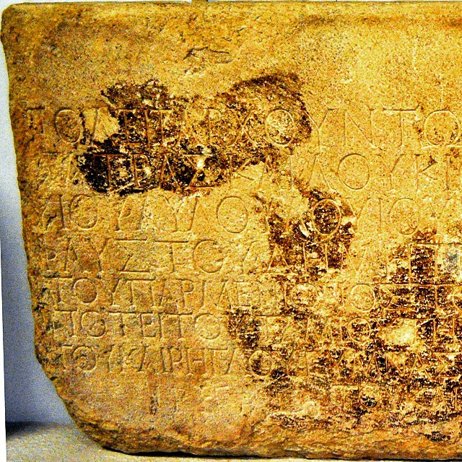

Slide 61
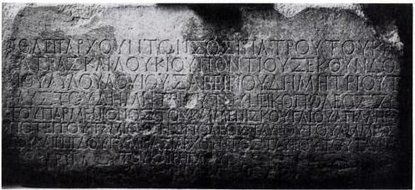
The Greek term translated here as ‘city officials’ is politarchs. Since the term doesn’t appear in classical literature, “Critics of the New Testament asserted for many years that Luke was mistaken in his use of the term ‘politarchs’ … for the officials of Thessalonica…”[13] However, an inscription using this term was found on a first-century AD arch torn down in 1867. As T.C. Mitchell describes it:

Slide 62
The Dead Sea Scrolls
In 1947 a Bedouin shepherd boy, searching for a lost goat, threw a stone into a cave opening in Qumran by the Dead Sea and heard the sound of shattering pottery. His inquisitiveness lead him to investigate and discover the first of what was to become known as the Dead Sea Scrolls. The world found out about them about one year later in 1948. The impact of this find on verifying the reliability of our Holy Scriptures cannot be overemphasized.

Slide 63
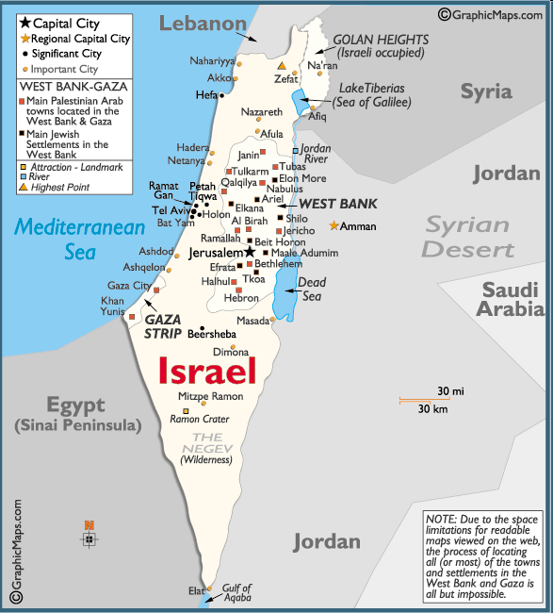
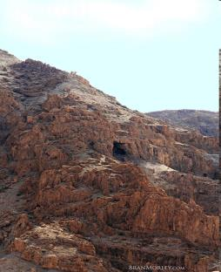
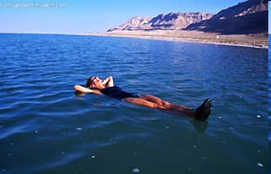
Where Is The Dead Sea?

Slide 64
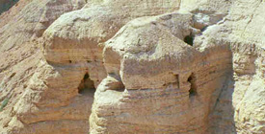
Dead Sea Scroll Facts
40,000 scroll fragments were found in jars in eleven different caves
35,000 scroll fragments from 400 manuscripts were found in Cave #4
All scrolls were produced prior to 67-73 AD (time of first Jewish-Roman war)
Literary remains of a Community that lived at Qumran from ~135 BC to ~67 AD
Scrolls contain samples of all OT books except Esther

Slide 65
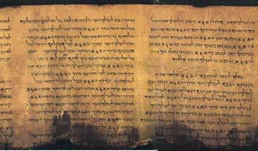
Dead Sea Scroll Facts
Complete scroll of Isaiah (dated about 125 B.C.) was found in Cave #1
No NT book scrolls found (too early)
Large number of Jewish non-canonical writings
Largest scroll, the Temple Scroll, was 27 feet long
William F. Albright, the dean of American archaeology, called it “the greatest manuscript discovery of modern times.”

Slide 66
Results of Dead Sea Finds
Extant copies of books that are more than 1000 years older than the extant copies previously known to exist
Significantly increased our knowledge of what happened to the Hebrew text from 1000-800 BC, from which time we trace our present Hebrew Bible
Hebrew text has undergone much less change than previously thought
Hebrew Bible text is treated with greater respect by scholars today than it has been for a long time
Brought to light much knowledge about the Jewish sect of the Essenes

Slide 67
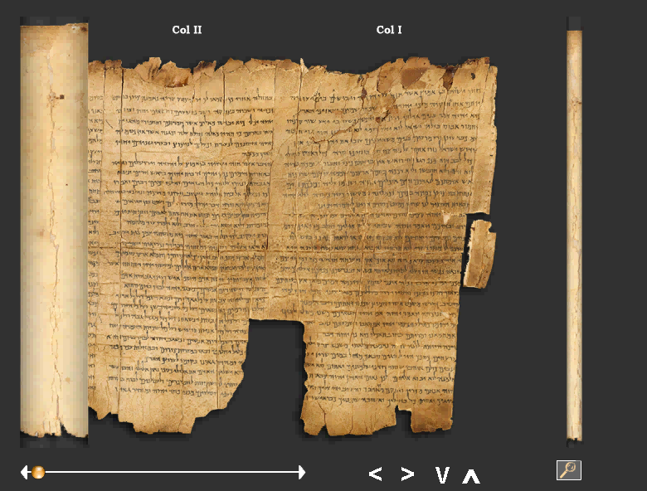
The Book of Isaiah
Only INTACT Scroll Found
ALL 66 Chapters

Slide 68
Isaiah Scroll’s
SIGNIFICANCE
OLDEST complete copy of any known biblical book
335-100 BC
ONLY known copy of entire book of Hebrew Bible
95% EXACT replica of what we study today
Of the 166 Hebrew words in Isaiah 53, only seventeen letters in Dead Sea Scroll 1QIs^{b} differ from the Masoretic Text (Geisler and Nix, 1986, p. 382).
10 letters = spelling differences
4 letters = stylistic changes
3 letters = added word for “light” (vs. 11)
______________________________________
17 letters = no affect on biblical teaching
Notes:
All 66 books

Slide 69
The Accuracy of The Scriptures
There are no historical, geographical or scientific errors in the Bible
This can be verified by a number of different external means:
  History, geography, archaeology and science
Extra-biblical writings by believers and non-believers alike have verified the accuracy of the Holy Scriptures
Archaeology has also verified the accuracy of transmission of the Holy Bible over the centuries

Slide 70
The NT Census
Historical accuracy of census in Luke
  Luke 2:1-5, “And it came to pass in those days that a decree went out from Caesar Augustus that all the world should be registered. This census first took place while Quirinius was governing Syria. … ”
  Herod’s census is to be distinguished from that of
  6 AD when Quirinius was in charge of the census, Acts 5:37
  Fragment of stone discovered at Tivoli near Rome in 1764 AD contains inscription in honor of Roman official who was twice governor/administrator of Syria [Quirinius]
  Quirinius was the commissioner for Syria and Palestine in 4 BC. In this capacity, Quirinius would be a delegate exercising the Emperor’s authority over the census in Palestine.
  Archaeology attests to accuracy of Luke’s record

Slide 71
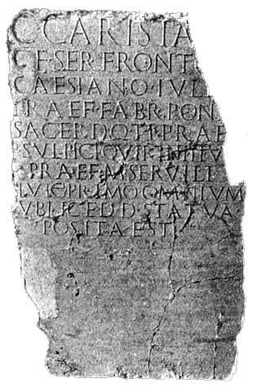

Slide 72
Luke’s Writings
Luke ascribed unfamiliar titles to authorities and named unknown governors
  Gallio, proconsul of Achaea, Acts 18:12-17
    Delphi inscription confirms him
  Lysanias, tetrarch of Abilene, Luke 3:1
    Inscription recording temple dedication
  Erastus, co-worker of Paul, Acts 19:22
    Inscription found in excavating Corinth
Luke’s records confirmed by secular historians
  Tacitus, Suetonius, Josephus, [the Talmud]

Slide 73
Luke’s Accuracy
Luke names key historical government figures in the correct time sequence and gives them the correct titles for their areas
Per writer A. N. Sherwin-White:
  “In all, Luke names 32 countries, 54 cities, and 9 islands without error.”
  “For Acts the confirmation of historicity is overwhelming. … Any attempt to reject its basic historicity must now appear absurd. Roman historians have long taken it for granted.”

Slide 74
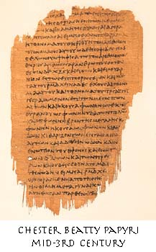
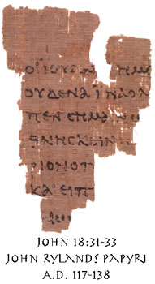
John Rylands Papyri
A small portion of John 18:31-33, discovered in Egypt. Known as the John Rylands Papyri and barely three inches square, it represents the earliest known copy of any part of the New Testament. The papyri is dated on paleographical grounds at A.D. 117-138 (though it may even be earlier), showing that the Gospel of John was circulated as far away as Egypt within 40 years of it's composition.

Slide 75
NT Sites
The existence of Jesus as recorded by Josephus, Suetonius, Thallus, Pliny the Younger, the Talmud, and Lucian
The foundation of the synagogue at Capernaum where Jesus cured a man with an unclean spirit (Mark 1:21-28)
The site of the Crucifixion (Mark 15:22)
Forcing Jews to leave Rome during the reign of Claudius (41-54 AD) (Acts 18:2), as recorded by Suetonius

Slide 76

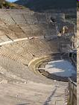
More NT Sites
Jacob’s Well where Jesus spoke to the Samaritan woman (John 4)
The court where Jesus
was tried (John 19:13)
The marketplace of Athens
[Areopagus] (Acts 17:19,22)
The Roman theater at Ephesus
(Acts 19:29)
Herod’s palace at Caesarea where
Paul was kept under guard
(Acts 23:33-35)

Slide 77
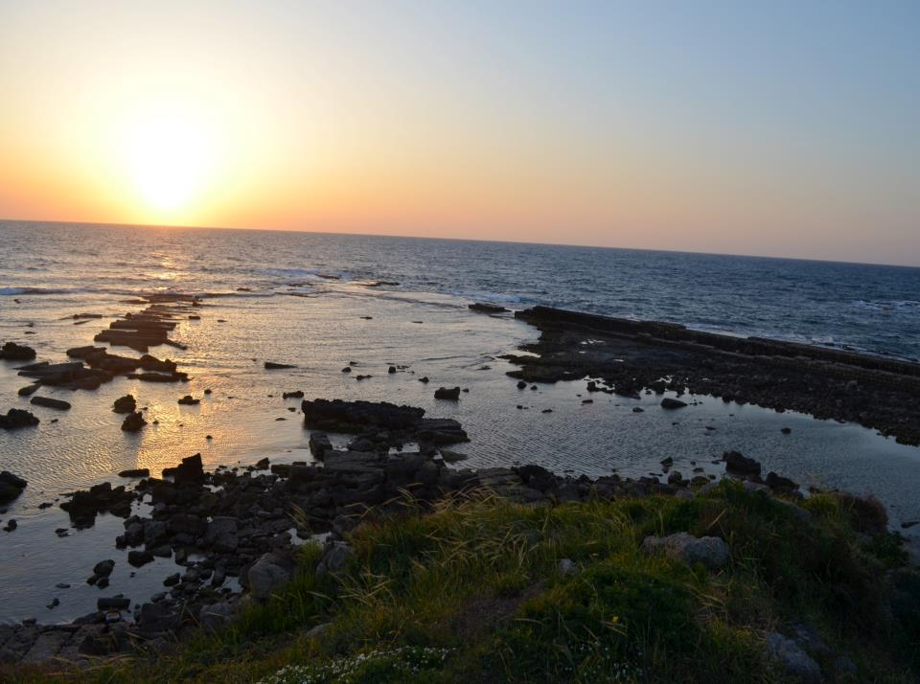
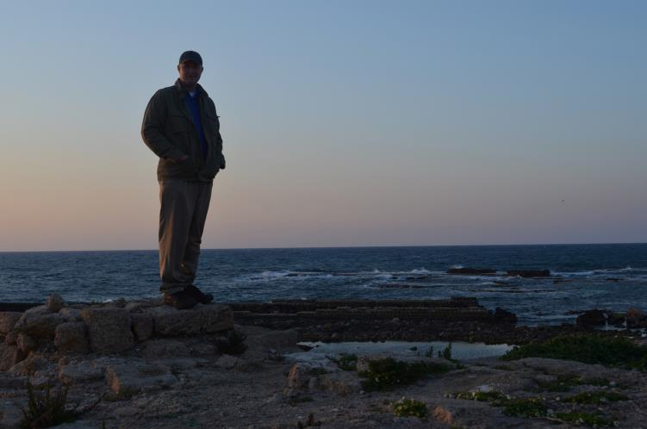
Caesarea

Slide 78
Josephus on Pontius Pilate
In Antiquities, Book 18 , Chapter 3
  But now Pilate, the procurator of Judea, removed the army from Cesarea to Jerusalem, to take their winter quarters there, in order to abolish the Jewish laws.
A procurator is a person who manages the affairs of another by virtue of a charge received from him (in this case, from the Roman Emperor)
Luke 3:1 says:
  Pilate was the governor of Judea
  Governor takes care of a place on behalf of the Emperor !

Slide 79
Nazareth Inscription
The ‘Nazareth decree’ is a marble slab found in Nazareth in 1878 and inscribed with a decree issued c. AD 41 by Emperor Claudius (AD 41-54) to the effect that no graves should be disturbed or bodies extracted, with offenders sentenced to death.
A plausible explanation of both the decree and its location is that Claudius heard of Jesus’ empty tomb whilst investigating the Roman riots of AD 49 and decided not to let such reports surface again. This makes sense in light of the Jewish argument that Jesus’ body had been stolen
Even if there is no conscious connection with Jesus of Nazareth, this decree still reveals that the imperial authorities in this period saw grave robbery as an extremely serious crime – indeed as a capital offence.
This only makes it yet more unlikely that the (already fearful) disciples would have risked such an act.

Slide 80
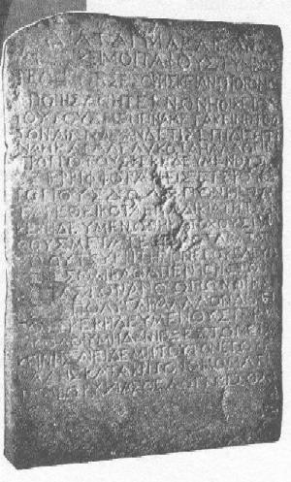

Slide 81
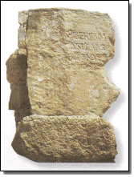
1962 - Pilate Inscription
Discovered at Caesarea in secondary use in a later wall, this inscription bears witness to a major New Testament figure and settles the debate over Pilot’s title of Prefect rather than the inferior Procurator.

Slide 82

Pilate Inscription
Line One: TIBERIEUM,,
Line Two: (PON) TIUS
Line Three: (PRAEF) ECTUS IUDA (EAE)
Meaning - Pilate had "dedicated a Tiberium, a public structure built in honor of the Roman emperor Tiberius."
This is the only known occurrence of the name Pontius Pilate in any ancient inscription.

Slide 83
Josephus on Jesus’ death
In Antiquities, Book 18 , Chapter 3
  Now there was about this time Jesus, a wise man, if it be lawful to call him a man; for he was a doer of wonderful works, a teacher of such men as receive the truth with pleasure. He drew over to him both many of the Jews and many of the Gentiles. He was [the] Christ. And when Pilate, at the suggestion of the principal men amongst us, had condemned him to the cross, those that loved him at the first did not forsake him; for he appeared to them alive again the third day; as the divine prophets had foretold these and ten thousand other wonderful things concerning him. And the tribe of Christians, so named from him, are not extinct at this day.
Note: verses in cyan were probably added later by some overly zealous Christian scribe

Slide 84
Tacitus on the Christian persecution
In Annals, Book XV:
  Consequently, to get rid of the report, Nero fastened the guilt and inflicted the most exquisite tortures on a class hated for their abominations, called Christians by the populace. Christus, from whom the name (Christians) had its origin, suffered the extreme penalty during the reign of Tiberius at the hands of one of our procurators, Pontius Pilatus, and a most mischievous superstition, thus checked for the moment, again broke out not only in Judaea, the first source of the evil, but even in Rome (see Acts !!!), where all things hideous and shameful from every part of the world find their centre and become popular.
  Accordingly, an arrest was first made of all who pleaded guilty; then, upon their information, an immense multitude was convicted, not so much of the crime of firing the city, as of hatred against mankind. Mockery of every sort was added to their deaths. Covered with the skins of beasts, they were torn by dogs and perished, or were nailed to crosses, or were doomed to the flames and burnt, to serve as a nightly illumination, when daylight had expired.

Slide 85
Importance of Tacitus’ testimony
Tacitus was a Roman Historian – he is neutral (not Jew, not Christian). His testimony is as unbiased as you can get
Tacitus testified that a multitude of Christians would die a cruel death for their faith – these Christians included Peter, Paul and other disciples of Jesus
Tacitus hinted at the miracle of Jesus’ resurrection:
  He called it a most mischievous superstition…

Slide 86
Pliny the Younger on the Christians
Pliny the Younger wrote many letters to his friend Emperor Tarjan to ask advice
In one of Pliny’s letter:
  Those who denied that they were or had been Christians, when they invoked the gods in words dictated by me, offered prayer with incense and wine to your (i.e., Emperor Trajan) image, which I had ordered to be brought for this purpose together with statues of the gods, and moreover cursed Christ -- none of which those who are really Christians, it is said, can be forced to do -- these I thought should be discharged.
Pliny basically said that real Christians cannot be forced into worshiping any other god

Slide 87
Pliny on how he identify a Christian
In a letter to Emperor Trajan, Pliny wrote:
  Meanwhile, in the case of those who were denounced to me as Christians, I have observed the following procedure:
  I interrogated these as to whether they were Christians; those who confessed I interrogated a second and a third time, threatening them with punishment; those who persisted I ordered executed....
All you need to do to save your neck was to denounce Jesus as your savior !
  Yet, real Christians rather chose death
  Why ? They saw Jesus die and came back to life...

Slide 88
Pliny was puzzled about the Christians
Pliny was clearly puzzled about these Christian criminals, he wrote in a letter:
  They (Christians) asserted, however, that the sum and substance of their fault or error had been that they were accustomed to meet on a fixed day before dawn and sing responsively a hymn to Christ as to a god, and to bind themselves by oath, not to some crime, but not to commit fraud, theft, or adultery, not falsify their trust, nor to refuse to return a trust when called upon to do so. I therefore postponed the investigation and hastened to consult you...
Clearly, these can’t be crimes punishable by death...

Slide 89
Suetonius on the expulsion of Jews
Roman Historian Suetonius wrote in “Life of Claudius”:
  As the Jews were making constant disturbances at the instigation of Chrestus (Christ?), he (Claudius) expelled them (Jews) from Rome.
There is one other historian that wrote about the expulsion of Jews from Rome:
  Acts 18:2 --- There he became acquainted with a Jew named Aquila, born in Pontus, who had recently arrived from Italy with his wife, Priscilla. They had been expelled from Italy as a result of Claudius Caesar's order to deport all Jews from Rome.
  This Historian was Luke !

Slide 90
Bible and Archeology
Unlike many other religious books, the Bible is a narrative in a historical setting
  It talks about historical places and historical persons
Many of the historical places and people mentioned in the Bible have been checked out by archeology
  The places and the people in the Bible are just as real as Alexander the Great, Julius Caesar and other well known historical things
  In fact, we have more accurate historical information on Jesus’ life and deeds than on Julius Caesar !

Slide 91
The Pool of Bethesda
John 5:1-15 mentions that Jesus heals a man at the Pool of Bethesda. John gave the precise location and a description of the pool as having 5 porticoes (pillars):
  John 5:1 --- After this there was a feast of the Jews, and Jesus went up to Jerusalem. Now there is a pool at the Sheep Gate at Jerusalem, which is called in Hebrew Bethesda, having five porches.
For a long time, skeptics cited this as an example that John’s Gospel was inaccurate because no such place had been found....
Notice that John did not need to describe the details of the pool (with its 5 pillars) in his gospel…

Slide 92
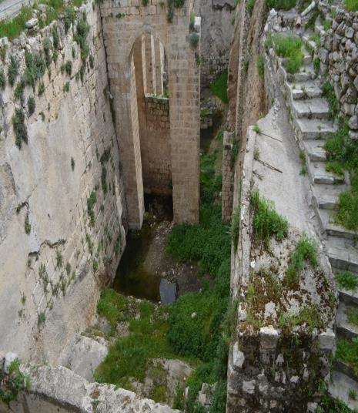
The Pool of Bethesda Found
In the 19th century, archaeologists discovered the remains of a pool exactly matching the description in John's Gospel

Slide 93
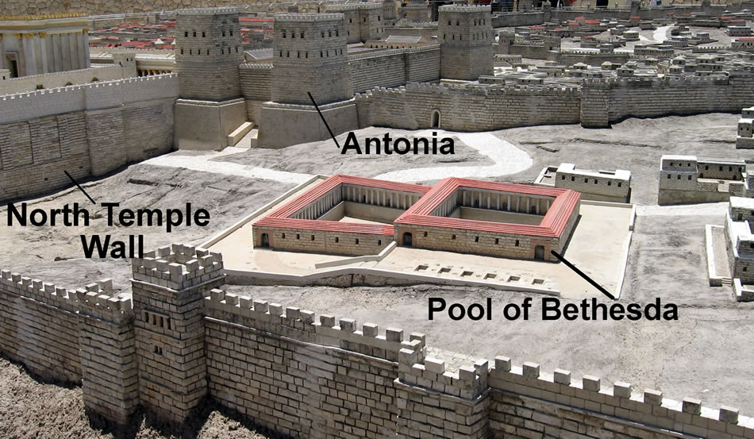
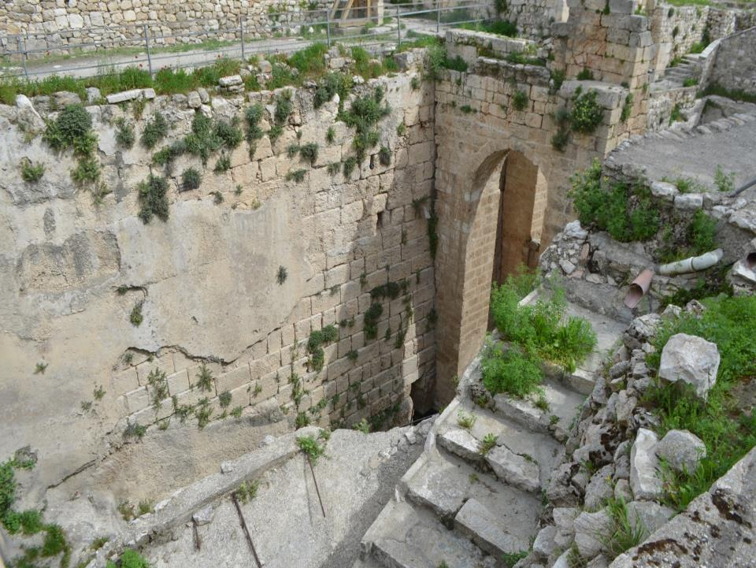
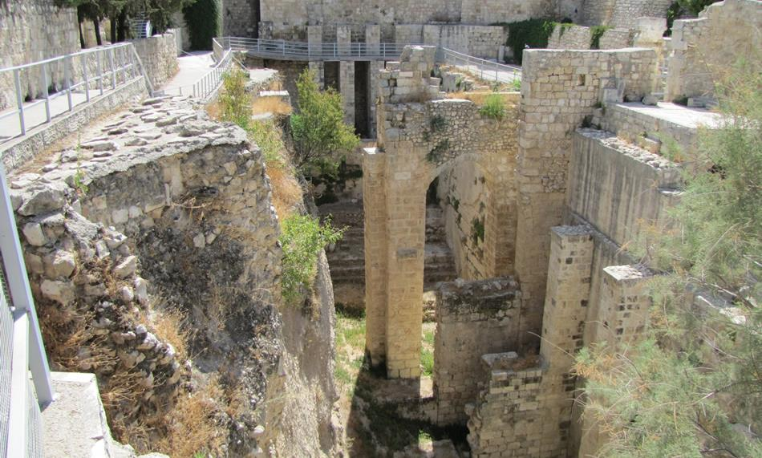

Slide 94
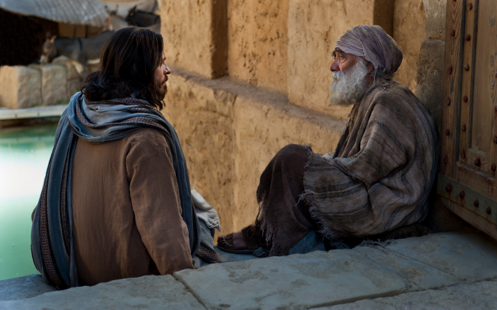

Slide 95
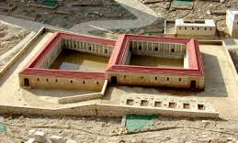

Slide 96
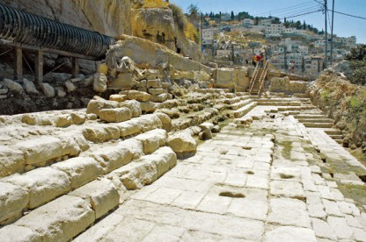
The Pool of Siloam (2004)
John 9:7 mentions another long disputed site: the Pool of Siloam near the Temple in Jerusalem
This pool was also discovered in 1897

Slide 97
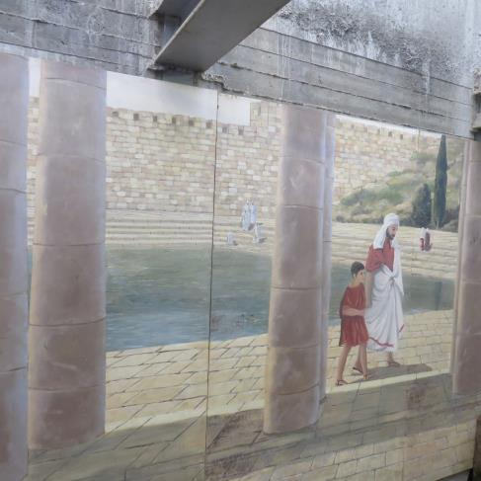
Pool of the Siloam
The Siloam Pool has long been considered a sacred Christian site, even if the correct identification of the site itself was uncertain. According to the Gospel of John, it was at the Siloam Pool where Jesus healed the blind man (John 9:1–11)

Slide 98
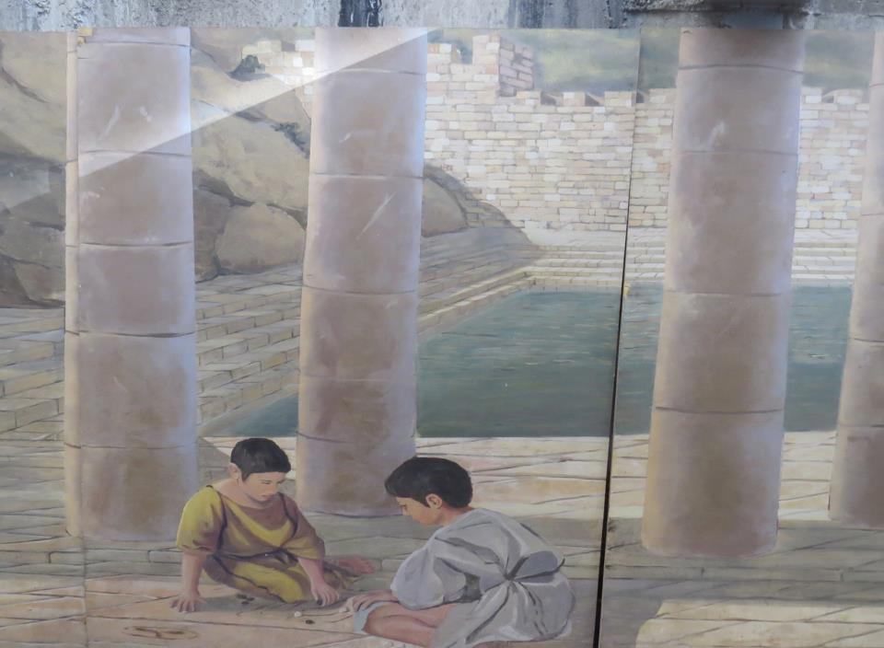

Slide 99
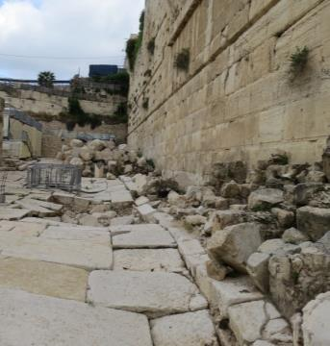
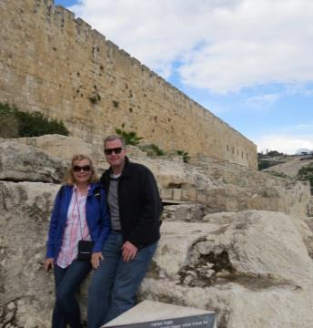
Destruction of Jerusalem

Slide 100
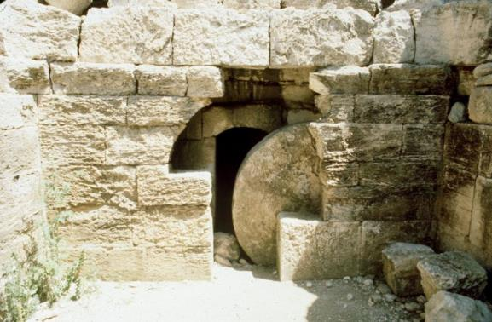
Rolling Stone burial tombs
The Bible said that Jesus was buried in a tomb that had a circular stone as“door”
They found many of these rolling stone tomb just outside Jerusalem...

Slide 101
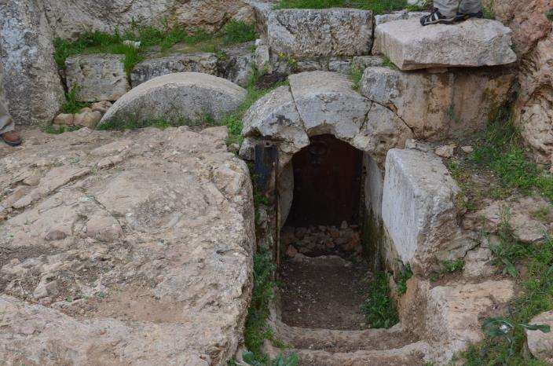
Herod’s Family Tomb

Slide 102


Slide 103
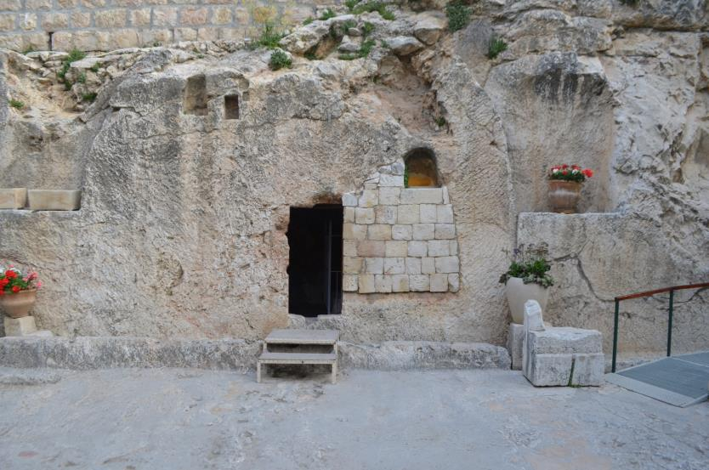
Notes:
Garden Tomb: Site of Possible Burial of Jesus

Slide 104
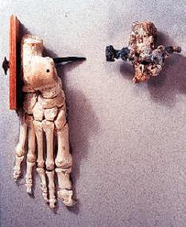
Crucifixion
Skeptics once had doubted that crucifixion was ever used – they deemed it too cruel
They found these remains in a ossuary (Jewish burial box) dated around 100 A.D.:
The nail was stuck and can’t be pull away – they saw away the wood of the cross to take the body down

Slide 105
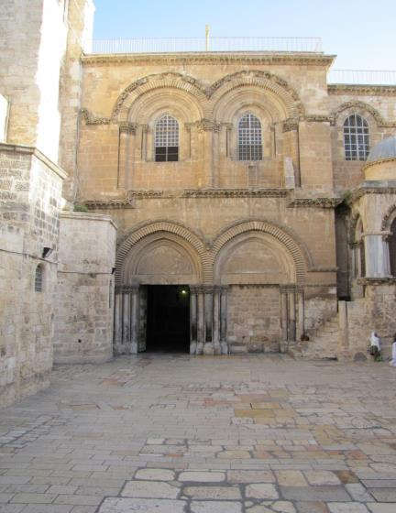
The Church of the Holy Sepulchre

Slide 106
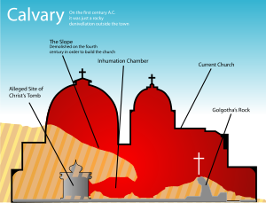

Slide 107
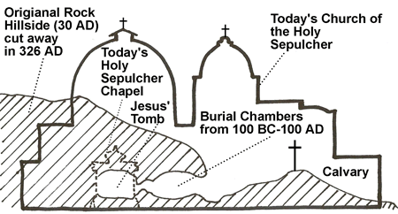


Slide 108
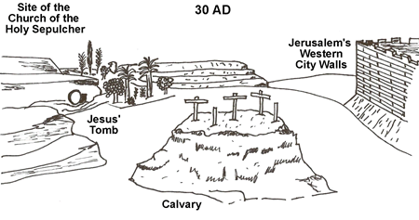
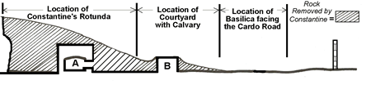

Slide 109


Slide 110

Pilate’s Coin
Judean bronze coin issued by Pilate in 30 CE. The Greek inscription reads (clockwise from the bottom left: Tiberiou [Ka]isaros ["of Tiberius Caesar"].
At the center is a lituus, a curved crook used by Roman augurs. Though this pagan religious symbol was used frequently on Roman coins minted outside Palestine, Pilate was the only Roman prefect to have put it on money issued for commerce among Jews.

Slide 111


1980 – Peter’s House
Beneath the foundations of this octagonal Byzantine martyrium church at Capernaum, archaeologists made one of the most exciting Biblical archaeology discoveries: a simple first-century A.D. home that may have been the house of Peter, the home of Jesus in Capernaum

Slide 112

Peter’s House
Notes:
25m south of synagogue lies the remains of an octagonal building. it is now thought that this building is on the site of Peter's house. Octagonal building thought to be a church from Byzantine era: ² probably middle 5th century AD
² similar to some European churches east side of middle octagon contained a baptistry² building faced east like most ancient churches ² octagonal churches built to commemorate special events which occurred at site. E.g., church of nativity in Bethlehem. Beneath church lies remains of another building, also a church.

Slide 113


Peter’s House
Notes:
² Gra±ti on wall: Lord JC help thy servant. Christ have mercy.
² Some gra±ti in Hebrew suggesting Jews part of church.
² Crosses on walls.
This earlier church appear to also have been a house. Some walls of building date back before Christ (approx 50 BC). Archaeologists have attempted to reconstruct the house based on what they have found.
² 2 interior courtyards (customary) ² no roof found suggesting it was straw/wood
(see Mk 2:1{12)
² largest room appears to have been modified and had large arch built into it so that its roof could be raised.
² originally house was fairly ordinary, like other houses in the area.
² During second half of the First century, floors, walls and ceiling were plastered (unusual). The only excavated house in town
with plaster. ² Walls and door were replastered several times over centuries.
² Before walls were plastered, lots of pottery, cooking bowls, jugs, etc.
² After walls plastered, only storage jars and some oil lamps.
² Suggests building became a public meeting hall.
² Given later gra±ti, it seems it became a Christian church.
Later: ² 4th century pilgrims said they saw the house of Peter. Egeria: \In Capernaum, a house church was made out of the home of the prince of the apostles whose walls still stand today as they were."
² 6th century travellers. \We came to Cap. to the house of St. Peter which is now a basilica [octagonal church]".
So there is reasonable evidence that this is the real thing, and if so, this is probably where Jesus lived in Capernaum.
Men let through roof. Mark 2:1{12 Could dig through this sort of roof.

Slide 114

Peter’s House

Slide 115
Where Jesus stayed
Jesus probably lived in Peter's house in Capernaum.
Mt 4:13. Went and lived in Capernaum
Mk 1:29-35. He stayed there that evening.
Mk 2:1. “Home" probably same place.

Slide 116

1990 - Ossuary of Caiaphas
Notes:
Bones of Caiaphas
In 1990, workers were building a park in Jerusalem. Underneath what is now a road, they accidentally uncovered an ancient burial cave. Not very surprising|the area is full of them. But this was interesting because it contained some ossuaries or bone boxes. When people were buried, their body was placed in a burial cave until its °esh had decomposed. Then the bones were collected and placed in an ossuary, usually made of decorated limestone. These were sometimes inscribed with the name of the family who owned the burial chamber.
OH: Caiaphas tomb

Slide 117


Slide 118


Herod’s Palace

Slide 119

Herod’s Palace
Praetorium

Slide 120
Praetorian
The Greek word (praitorion) thus rendered in Mark 15:16 is rendered "common hall" ( Matthew 27:27 , marg., "governor's house"), "judgment hall," ( John 18:28 John 18:33 , marg., "Pilate's house", 19:9 ; Acts 23:35 ), "palace" (Phil 1:13 ). This is properly a military word. It denotes (1) the general's tent or headquarters; (2) the governor's residence, as in Acts 23:35 (RSV, "palace"); and (3) the praetorian guard (See PALACE), or the camp or quarters of the praetorian cohorts ( Acts 28:16 ), the imperial guards in immediate attendance on the emperor, who was "praetor" or commander-in-chief.

Slide 121
Context of Mark 8:27 and Matthew 16:18
Having just come from Bethsaida, Jesus decided to take his disciples on a 32+ mile round trip to Caesarea Philippi
The only recorded trip Jesus took to that region or anywhere remotely like it.

Slide 122

Banias (Panias)

Slide 123
Matthew 16:18
It was the summer of AD 29, and before His imminent death Jesus Christ wanted to bring His disciples to Caesarea Philippi where He would revealed to them for the first time that He was indeed the Messiah.
The city of Caesarea Philippi, also known as ancient Panias was situated way in the north about 30 miles past the Sea of Galilee on a terrace at the foot of Mount Hermon on its southern slope, about 1150 feet above sea level.

Slide 124

Rock of the Gods
Caesarea Philippi, the modern day reserve of Banias in the Golan Heights region of Israel, was established by Ptolemaic Greeks as a hellenistic city, where the worship of the god Pan was centered.
By the early first century, Caesarea Philippi (named in 2 AD by Herod Philip in honor of Caesar Augustus) was reviled by orthodox rabbis, and it was taught that no good Jew would ever visit there.

Slide 125

In this Painting of the First Century Sanctuary of Pan there is depicted from left to right: 1. The Temple of Augustus Called the Augusteum (On the Left) 2. The Grotto or Cave of the God Pan (Behind the Temple of Augustus) 3. The Court of Pan and the Nymphs (To the Right of the Temple of Augustus) 4. The Temple of Zeus (In the Middle) 5. The Court of Nemesis (To the Right of the Temple of Zeus) 6. The Tomb Temple of the Sacred Goats (Upper Right) 7. The Temple of Pan and the Dancing Goats (Bottom Right)

Slide 126

Rock of the Gods
This city, which sits at the foot of Mount Hermon, butts up against a large cliff, referred to as the ‘Rock of the Gods’, in reference to the many shrines built against it.
Shrines to Caesar, Pan and another god (possibly the fertility goddess Nemesis) were all built up against this cliff.

Slide 127
Matthew 16:18
The area had an unusually beautiful setting, it was very lush and full of life and it has always been one of the main sources of the Jordan River, Josephus saying that it was the chief source.
The ancient Canaanites built a sanctuary to Baal at Panias, the Greeks and Romans both built sanctuaries there because of the cave of Pan.
Inside the cave was a seemingly bottomless pit with an unlimited quantity of water which made the pagans marvel.

Slide 128

The Cave of Pan
In the center of the Rock of the Gods is a huge cave, from which a stream flowed (after 19th century earthquakes, the stream began flowing out from the rock beneath the mouth of the cave).
This cave was called the “Gates of Hades”, because it was believed that Baal would enter and leave the underworld through places where water came out of it.

Slide 129

The Cave of Pan
(Gates of Hades)
The Gates of Hades

Slide 130
Why this place?
Caesarea Philippi was mentioned only twice in the Bible, both referring to the same event where Jesus chose to reveal to His disciples that He was the Messiah.
He also announced His coming death in Jerusalem and the end of His earthly ministry and beginning of theirs.
Why would Jesus choose this place to reveal who He was to His disciples, so far north of the Sea of Galilee?

Slide 131
The Cave of Pan
The Cave of Pan (or Grotto of Pan) was amazing because of many reasons;
The waters flowed out of the cave and fed the Jordan River
There was a bottomless pit inside that contained so much water that it could not be measured.
The place was so striking that it impressed Alexander the Great, and the Greeks built a sanctuary there.

Slide 132


Panias

Slide 133

Pan
Natural features not only impressed the Greeks but they believed them to be a dwelling place of the gods, and nothing produced more awe and terror than a place identified as a cave where the god Pan dwelt.
Pan was responsible for the scary noises in the forest and many mysteries were associated with him that brought great fear.
The Romans were heavily influenced by the Greeks and they followed many of their religious traditions.

Slide 134

Panias

Slide 135
Panias
In the open-air Pan Shrine, next to the cave mouth, there was a large niche, in which a statue of Pan (a half-goat, half-human creature) stood, with a large erect phallus, worshipped for its fertility properties.
Surrounding him in the wall were many smaller niches, in which were statues of his attending nymphs.
On the shrine in front of these niches, worshippers of Pan would congregate and partake in bizarre sexual rites, including copulation with goats – worshipped for their relationship to Pan.

Slide 136
Simon Peter answered, “You are the Christ, the Son of the living God.” (Matthew 16:13-16)
It was here in the Pagan city that Jesus asks his disciples “Who do people say the Son of Man is?

Slide 137

Ossuary of Caiaphas

Slide 138

Ossuary of Caiphas

Slide 139

1990 - Ossuary of Caiaphas
From the Caiaphas family tomb in Jerusalem, this ossuary bears the inscription "Yehosef bar Qafa: (Joseph, son of Caiaphas), and it is dated to the Second Temple Period. Caiaphas is the name of the High Priest who presided over the trial of Jesus.
Notes:
On the side of one of the ossuaries found in this cave was the name \Caiaphas". On the side of another ossuary was \Joseph, son of Caiaphas". The cave has been dated to between the ¯rst century BC and the ¯rst century AD. In one of the ossuaries was found a coin dated to AD 42/43. Precisely the time for the high priest Caiaphas who we know from the NT. Caiaphas was the high priest during the time of Jesus' ministry and the gospels record he took a lead- ing part in Jesus' trial and subsequent cruci-¯xion. In Josephus', he calls the high priest at the time \Joseph who was called Caiaphas". It seems Caiaphas was a family name and his real name was Joseph. That would explain why the ossuary was inscribed, Joseph son of Caiaphas. of the others, and no doubt belonged to a spe- cial person. Inside this beautiful ossuary, they found bones from six di®erent people: two ba- bies, a child between 2 and 5, a young boy be- tween 13 and 18, an adult woman, and a male of about 60 years!
Could this have been Caiaphas himself? It seems highly likely.

Slide 140

Ossuary of Caiaphas
Ossuary contained the bones of a man of about 60 years old, a woman, two children and two infants.

Slide 141

Ossuary of Caiaphas

Slide 142

Caiphas Tomb – Other Artifacts
Notes:
Ceramic oil lamp
A pot
Small glass bottle (possibly for holding precious liquids)

Slide 143
Josephus on James, brother of Jesus
In Antiquities, Book 20, Chapter 9:
  Festus was now dead, and Albinus was but upon the road; so he assembled the sanhedrim of judges, and brought before them the brother of Jesus, who was called Christ, whose name was James, and some others, [or, some of his companions]; and when he had formed an accusation against them as breakers of the law, he delivered them to be stoned...
Clearly, Jesephus does not accept that Jesus is the Christ (who was called Christ)
Josephus does confirm that:
  Jesus existed
  Jesus had a brother called James (see Galatians 1:18-19)
  James died for a religious cause !

Slide 144

2002 – James’ Ossuary
The letters etched into this ancient limestone object read, 'James, son of Joseph, brother of Jesus.'
Mk 6;3
Notes:
Bones of James
A few months ago, another bone box was found. This was actually found at least 20 years ago, and had been sitting in someone's
house all that time. They didn't realise how important it was.
On the side it said \Jacob, the son of Joseph, the brother of Joshua". Jacob=James. Joshua=Jesus.
Mark 6:3.
There may have been lots of people called James who had fathers called Joseph and pos- sibly even a few who also had brothers called Jesus. But to put it on a box was unusual. Would only do it if the brother was famous! What was in box?
Nothing! It had been emptied out and no-one knows what happened to the bones.

Slide 145

2002 – James’ Ossuary
Earliest mention of Jesus outside the Bible
  Scans by electron microscope show no trace of modern tools
  Grammer and script appear to fit normal useage of the period
Notes:
Size of a toolbox
A year after burial in tomb, family members would collect bones into an ossuary. Tombs wer carved into rocks and expensice – so were reused
Is it real?

Slide 146

2002 – James’ Ossuary
Aramaic inscription "Ya'akov bar Yosef akhui di Yeshua."

Slide 147

Still being debated
Two groups of specialists—from the Geological Survey of Israel and the Royal Ontario Museum, in Toronto—studied the bone box and concluded the inscription was ancient.
And some of the world’s leading paleographers—specialists in ancient scripts—have dated the inscription’s style of writing to the first century A.D.

Slide 148

James’ Ossuary
If crucifixion had been the final event in Jesus' earthly life, then it is hard to believe that 30 years later someone would be bragging on an ossuary about being related to him.
The last part of the inscription reads, almost emphatically, "his brother [is] Jesus!" or "He's the brother of Jesus!" What had happened that redeemed the honor of the crucified Jesus? It was his resurrection.

