Slide 2

Gospel Meeting
Donnie V. Rader
dvrader@live.com

Slide 3
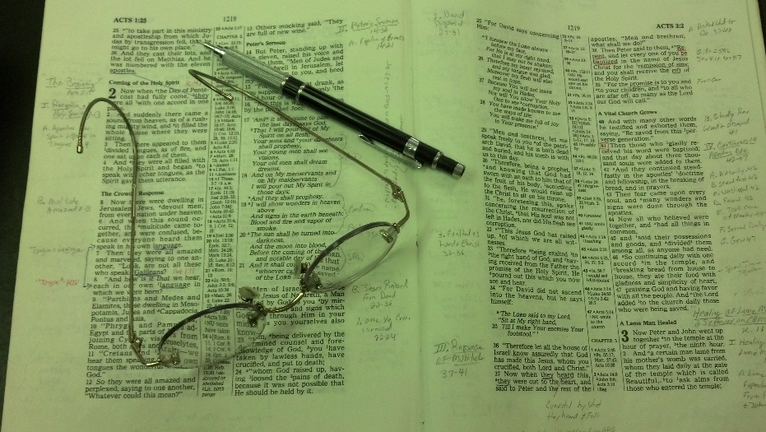
Topics
Monday: Is One Faith as Good as Another?
Tuesday: Bible Authority
Wednesday: Selling and Stirring
Thursday: The Seduction of Joseph
Friday: The Wayward Son Comes Home

Slide 4
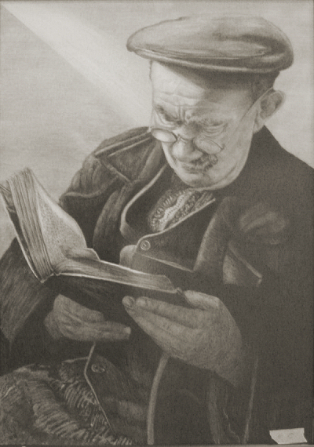
Wisdom
&
Judgment

Slide 5
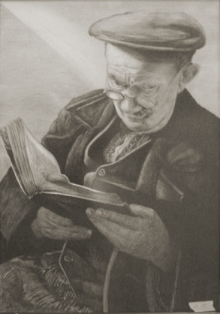
Wisdom & Judgment
Many of our problems are brought on, not by sinful decisions and actions, but bad judgment
“Good judgment comes from experience; experience comes from bad judgment.”
Part of the struggle is those with poor judgment don’t always know – have poor judgment!

Slide 6

Bible Gives Us Wisdom
Wisdom is not always found in a book
Wisdom can’t be learned in crash course
Wisdom / Judgment can’t be bought at store

Slide 7
Wisdom & Judgment
I. Knowing What It Is
I. Knowing What It Is

Slide 8
I. Knowing What It Is
Wisdom
Poor
Judgment
A. More than things not sinful

Slide 9
Colossians 1:9
For this reason we also, since the day we heard it, do not cease to pray for you, and to ask that you may be filled with the knowledge of His will in all wisdom and spiritual understanding;

Slide 10
Wisdom & Understanding
“He will do only that which is in his spiritual interest, or what is good for him on a spiritual level. Some things even right in themselves are not best for the Christian. It does not necessarily take all wisdom and spiritual understanding to know the difference between right and wrong, or the good and the bad. But it does require such wisdom and understanding to know the better over the good, and the best over the better, and having recognized the difference to then make the best choice rather than just refuse the bad.” - Weaver

Slide 11
Sin
Good / Right
Decision /
Action
Since it is not sinful – no problem at all!

Slide 12
Sin
Bad
Better
Best
Decision /
Action
Though not sinful – may not be good at all!

Slide 13
I. Knowing What It Is
Wisdom
Poor
Judgment
A. More than things not sinful
B. More than knowledge
For this reason we also, since the day we heard it, do not cease to pray for you, and to ask that you may be filled with the knowledge of His will in all wisdom and spiritual understanding;

Slide 14
“Wisdom”
“Wisdom” = God’s Revelation (Prov. 4)
“Wisdom” = Insight / Judgment (Jas. 1:5)

Slide 15
Knowledge
Wisdom
Know what Word Teaches | How much at one time How to approach
How to use PowerPoint | How much flashy Animation to use
Value of Jewelry | Whether to comment on someone’s ring
How to do something Better than another | How I handle that Knowledge / comment
Learn some facts about another’s $ | What I do with what I have learned

Slide 16
I. Knowing What It Is
Wisdom
Poor
Judgment
A. More than things not sinful
B. More than knowledge
C. Able to see beyond the present

Slide 17
James 1:1-6
1 James, a bondservant of God and of the Lord Jesus Christ, To the twelve tribes which are scattered abroad: Greetings.
2 My brethren, count it all joy when you fall into various trials,
3 knowing that the testing of your faith produces patience.
4 But let patience have its perfect work, that you may be perfect and complete, lacking nothing.
5 If any of you lacks wisdom, let him ask of God, who gives to all liberally and without reproach, and it will be given to him.
6 But let him ask in faith, with no doubting, for he who doubts is like a wave of the sea driven and tossed by the wind.
Wisdom to see the good in the suffering of the moment

Slide 18
I. Knowing What It Is
Wisdom
Poor
Judgment
A. More than things not sinful
B. More than knowledge
C. Able to see beyond the present
D. Maturity in judgment
1. Prov. 20:29 – glory of old men
2. Jas. 1:4 – perfect = mature
3. Heb. 5:13-14 – full age can discern

Slide 19
Age does not always mean wisdom / good judgment
Prov. 16:31
“Wisdom does not always comes with age, sometimes age comes all by itself”

Slide 20
I. Knowing What It Is
Wisdom
Poor
Judgment
A. More than things not sinful
B. More than knowledge
C. Able to see beyond the present
D. Maturity in judgment
E. Sober-minded

Slide 21
Sober-minded
Titus 1:8 – elders to be sober-minded
Titus 2:2 – older men to be sober
Titus 2:6 – younger men to be sober-minded
Sober = Serious minded
“of a sound mind” (Vines)
Serious, level headed
Translated “in his right mind” (Mk 5:15; Lk. 8:35)

Slide 22
I. Knowing What It Is
Wisdom
Poor
Judgment
A. More than things not sinful
B. More than knowledge
C. Able to see beyond the present
D. Maturity in judgment
E. Sober-minded

Slide 23
Wisdom & Judgment
I. Knowing What It Is
I. Knowing What It Is
II. Knowing Its Sources
II. Knowing Its Sources
Where can I go get it?
How can I know what is the wise course?

Slide 24
II. Knowing Its Sources
A. Word of God
1. Know the Bible (Deut. 6; Eph. 3:3-5; 2 Pet. 3:18)
2. Decisions & actions should be aimed to harmonize with and accomplish the goal found in word
3. “Wisdom” books (i.e. Proverbs) [18:13, 17]
4. “Whatever is at the center of our life will be the source of our security, guidance, wisdom, and power” (Stephen Covey)

Slide 25
II. Knowing Its Sources
A. Word of God
B. Multitude of Counselors
1. Prov. 11:14; 15:22; 24:6
2. Ask for advice – from more than one
3. Must be open to a different judgment
4. “He that never changes his opinion, never corrects his mistakes, and will never be wiser on the morrow than he is today” (Tryon Edwards)

Slide 26
II. Knowing Its Sources
A. Word of God
B. Multitude of Counselors
C. Experience
1. We learn from experience (Gen. 30:27)
2. Elders learn from experience of dealing with own children (1 Tim. 3:5)

Slide 27
II. Knowing Its Sources
A. Word of God
B. Multitude of Counselors
C. Experience
D. Pray
1. Should pray for wisdom (Jas. 1:5)
2. Should ask God daily for wisdom….

Slide 28
Wisdom & Judgment
I. Knowing What It Is
I. Knowing What It Is
II. Knowing Its Sources
II. Knowing Its Sources
III. Knowing Where It Is Needed
III. Knowing Where It Is Needed

Slide 29
III. Knowing Where It Is Needed
A. Raising Children
1. Goal / objective (Prov. 22:6; Eph. 6:1-4)
2. Very careful in decision we make about children
3. Watch: what doing, who with, who talk to, what they do, e-mails they get, music they listen to, movies watch, what is being said on Facebook & Twitter

Slide 30
III. Knowing Where It Is Needed
A. Raising Children
B. Dealing with People (Col. 4:5)
1. What to say
2. How to say it
3. How to respond
4. When do I ignore when do I reply?

Slide 31
III. Knowing Where It Is Needed
A. Raising Children
B. Dealing with People (Col. 4:5)
C. Conduct with the Opposite Sex
1. Prov. 5:8 – stay clear of tempting situation
2. Prov. 6:25 – watch for allurements
3. How does the situation look to others?
4. Could this be a compromising situation?

Slide 32
III. Knowing Where It Is Needed
A. Raising Children
B. Dealing with People (Col. 4:5)
C. Conduct with the Opposite Sex
D. Topics Discussed (esp. in mixed company)
E. When we Talk

Slide 33
When We Talk
Prov. 15:1 – soft answer turns away wrath…
Prov. 15:2 – tongue of wise uses knowledge
Prov. 17:28 – Fool is wise when he hold tongue
“It is so simple to be wise. Just think of something stupid to say and then don’t say it.”
- Sam Levenson

Slide 34
III. Knowing Where It Is Needed
A. Raising Children
B. Dealing with People (Col. 4:5)
C. Conduct with the Opposite Sex
D. Topics Discussed (esp. in mixed company)
E. When we Talk
F. Timing

Slide 35

Timing
Job 5:25 –Eliphaz’s timing stunk
Ecc. 3:1-8 – Don’t laugh when time to cry

Slide 36
III. Knowing Where It Is Needed
A. Raising Children
B. Dealing with People (Col. 4:5)
C. Conduct with the Opposite Sex
D. Topics Discussed (esp. in mixed company)
E. When we Talk
F. Timing
G. Choosing Friends

Slide 37

Watch Your Friends
Prov. 12:26
“The righteous should choose his friends carefully,
For the way of the wicked leads them astray.”
Will they influence you – to be weaker?
Will they help you be stronger?
Will they break down resistance (Psa. 1:1)?
Do they have the same standards?
Are their “problems” worse than anger (Prov. 22:24-25)?

Slide 38
Wisdom & Judgment
I. Knowing What It Is
I. Knowing What It Is
II. Knowing Its Sources
II. Knowing Its Sources
III. Knowing Where It Is Needed
III. Knowing Where It Is Needed
IV. Knowing How We Show It
IV. Knowing How We Show It

Slide 39
IV. Knowing How We Show It
A. Show wisdom in our actions
1. Jas. 3:13 – show wisdom in actions
2. Not by telling others how wise we are
3. Show it in decisions we make, things say…

Slide 40
IV. Knowing How We Show It
A. Show wisdom in our actions
B. Problem with bad judgment – not thinking
1. Have a limited focus
2. Look ahead & beyond (i.e. Jas. 1:5)
3. See consequences, where this will lead, whether we can be consistent
4. “We are made wise not by the recollection of our past, but by the responsibility for our future” (G. B. Shaw)

Slide 41

Looking Ahead
See Dangers
How things look to others
How others are affected
How we come across
Any precedent we set
Consequences of what I allow

Slide 42
IV. Knowing How We Show It
A. Show wisdom in our actions
B. Problem with bad judgment – not thinking
C. Not Rash – but Deliberate

Slide 43
Not Rash
Eccl 5:2
Do not be rash with your mouth, And let not your heart utter anything hastily before God. For God is in heaven, and you on earth; Therefore let your words be few.
Prov. 15:28
The heart of the righteous studies how to answer, But the mouth of the wicked pours forth evil.
Time to answer
Time to think things through
Not quick to make decisions

Slide 44
Wisdom & Judgment
I. Knowing What It Is
I. Knowing What It Is
II. Knowing Its Sources
II. Knowing Its Sources
III. Knowing Where It Is Needed
III. Knowing Where It Is Needed
IV. Knowing How We Show It
IV. Knowing How We Show It

